Slide 1
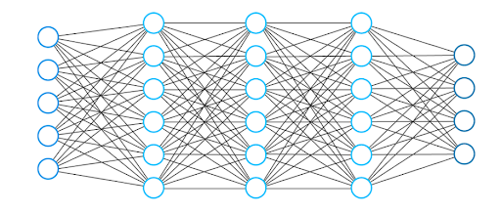
Deep Learning
Joseph Li

Slide 2
Problem
Using ChatGPT, I created a binary classification problem
Involves loan defaults
Each row represents an applicant
Goal is to predict whether applicant defaults or not

Slide 3
Dataset and Curation
Columns
Age
Dataset
Default is the target variable, and it is set to a binary label
Curation
No missing values or issues
Income
Credit score
Debt/income ratio
Number of late payments
Default
Dataset has 500 different loan applicants
Ready for analysis

Slide 4
Deep Learning Model
Multilayer perceptron model
Input layer
Dense layer (32 neurons)
Dense layer (16 neurons)
Dense layer (8 neurons)
Dense layer (1 neuron, Sigmoid Function)

Slide 5
Analysis Steps
Downloaded the CSV file
Asked ChatGPT to generate Python code to run deep learning on the data
Read the file
Split data into 80% training, 20% testing
Run the model on the data
Reported results
Confusion matrix
Accuracy score
Recall for clients who defaulted

Slide 6
Results
Presenting the results
Helpful to see predictions made and evaluate performance
Deep learning model reported scores
Reflection
Accuracy score of 85%
Recall score of 29.41%
Model is pretty accurate in predicting whether an applicant will default
Used a confusion matrix
Struggles to identify who would truly default

Slide 7
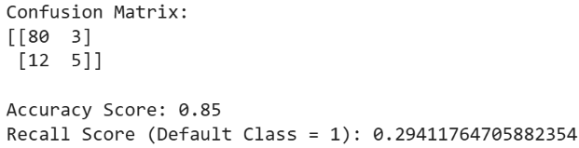
Confusion Matrix and Scores

Slide 8
Lessons Learned
Deep learning strengths and weaknesses
Deep learning is a mediocre model to predict a default with this data
Not bad due to decent accuracy score
Other models such as logistic regression better suited
Good accuracy on whether someone will default or not
Low recall score for identifying defaults

Slide 9
Works Cited
https://chatgpt.com/share/69a08ac7-16a4-8008-8ba8-ad106ac3cd41

